Slide 1
Data Visualization
Kaidi Wang
kdwang@must.edu.mo
Office: O913
Office hour: 14:00 – 15:00 on Mon., Tue., Wed., Thu.

Slide 2
Usage of data visualization
Data visualization is very helpful for identifying data errors and outliers, e.g., boxplot and scatter plot
It can also be used to reveal the relationships and the trends.
It is more intuitive for decision makers to understand the data.

Slide 3
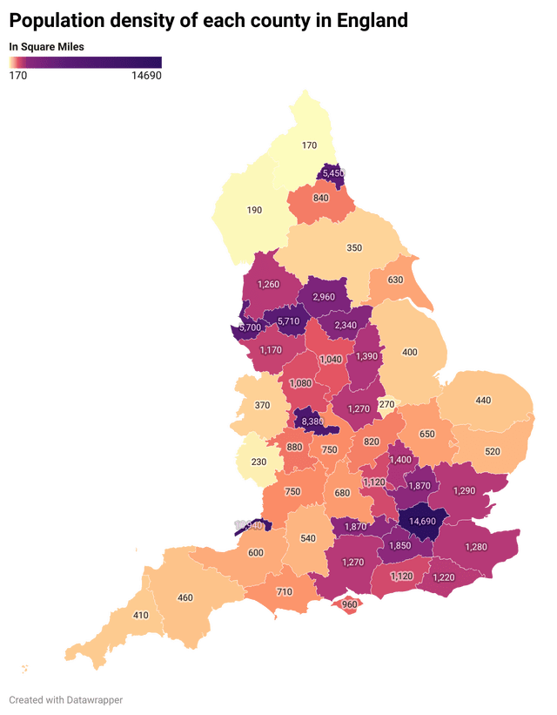
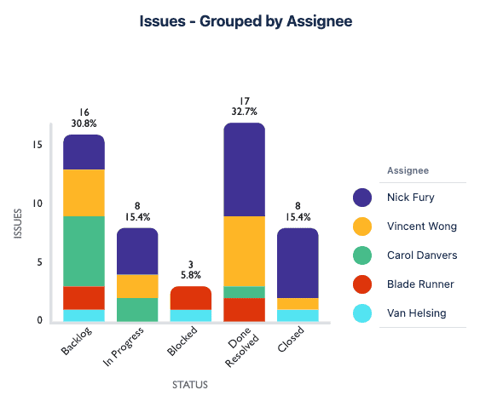
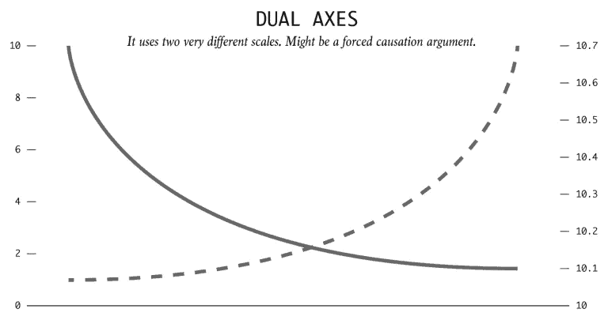
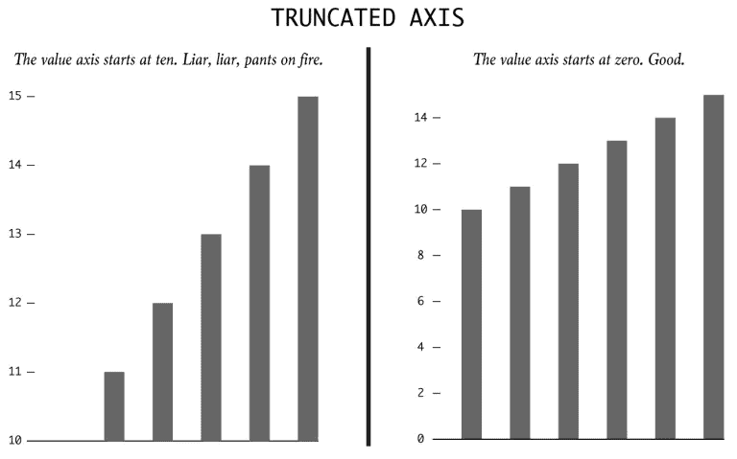
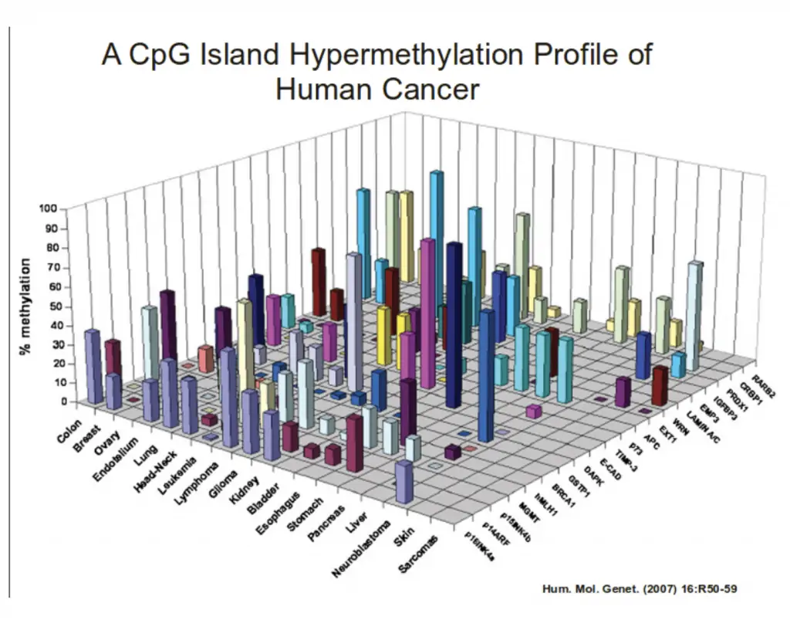
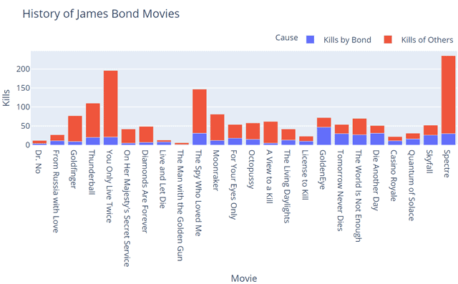
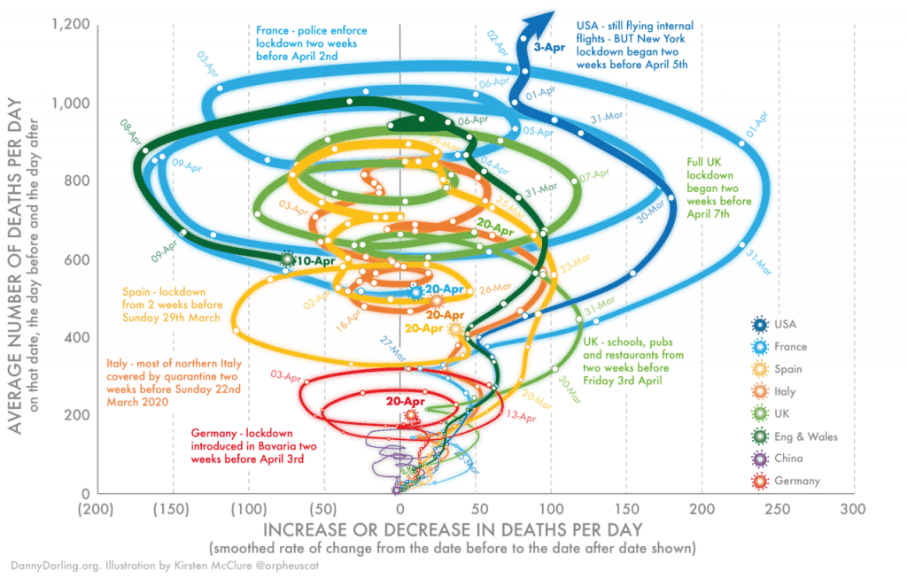
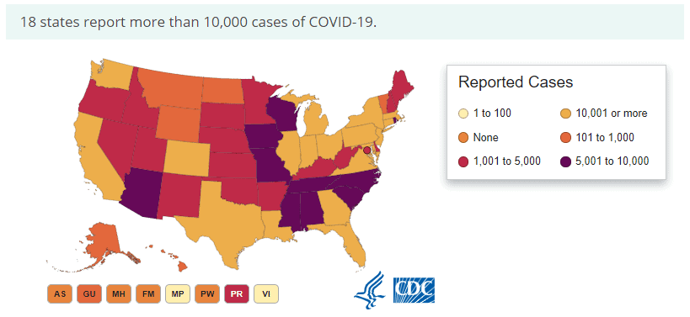
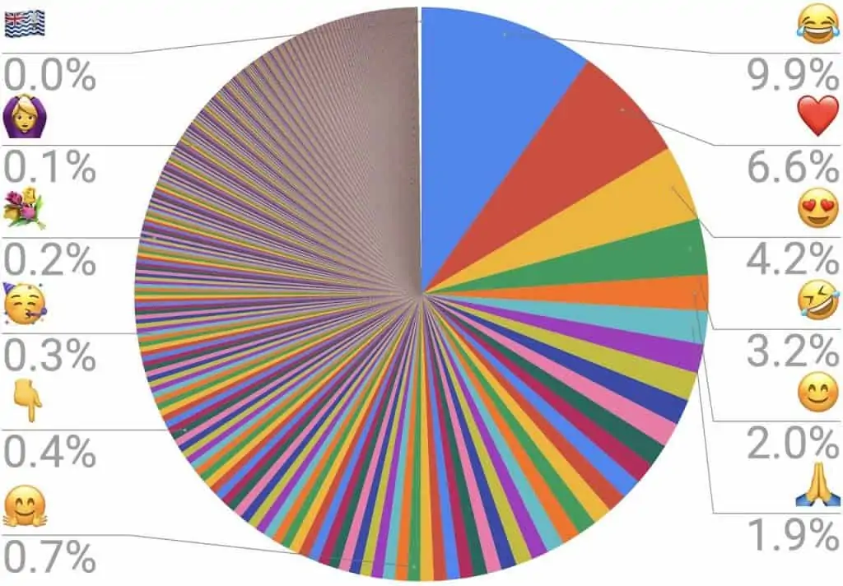
3

Slide 4
Effective design techniques
Data-ink ratio: Measures the proportion of “data-ink” to the total amount of ink used in a table or chart. - Edward R. Tufte
Data-ink: Ink used in a table or chart that is necessary to convey the meaning of the data to the audience.
Non-data-ink: Ink used in a table or chart that serves no useful purpose in conveying the data to the audience.

Slide 5
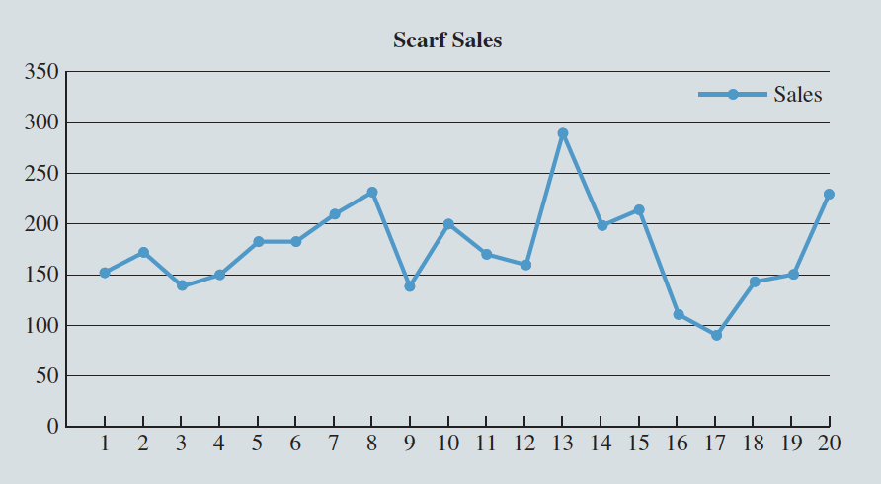
Increasing data-ink ratio
Day | Sales | Day | Sales
1 | 150 | 11 | 170
2 | 170 | 12 | 160
3 | 140 | 13 | 290
4 | 150 | 14 | 200
5 | 180 | 15 | 210
6 | 180 | 16 | 110
7 | 210 | 17 | 90
8 | 230 | 18 | 140
9 | 140 | 19 | 150
10 | 200 | 20 | 230

Slide 6
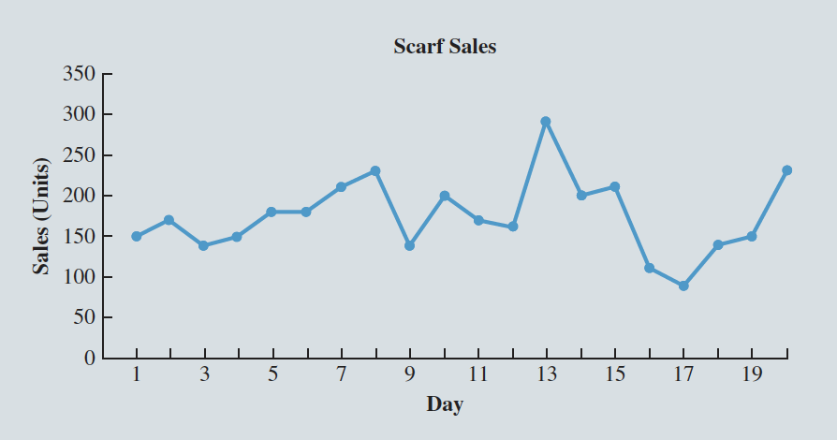
Increasing data-ink ratio
Day | Sales | Day | Sales
1 | 150 | 11 | 170
2 | 170 | 12 | 160
3 | 140 | 13 | 290
4 | 150 | 14 | 200
5 | 180 | 15 | 210
6 | 180 | 16 | 110
7 | 210 | 17 | 90
8 | 230 | 18 | 140
9 | 140 | 19 | 150
10 | 200 | 20 | 230
How do you think?

Slide 7
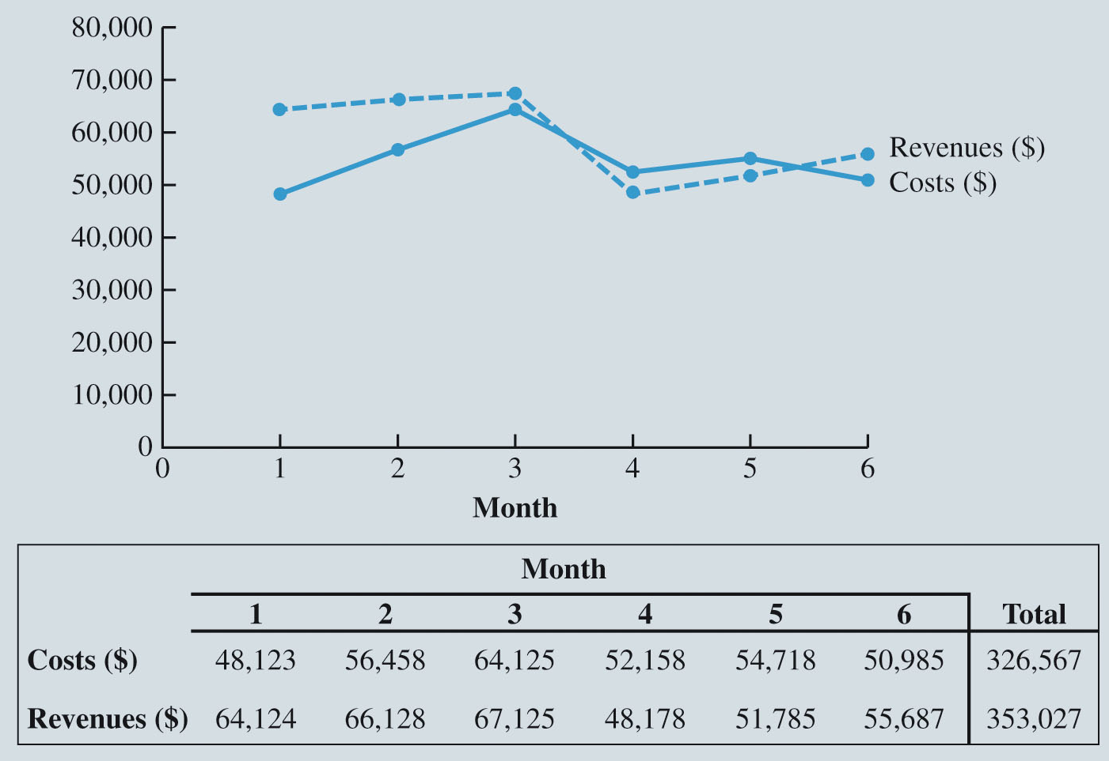
When to use tables?
The reader needs to refer to specific numerical values.
The reader needs to make precise comparisons between different values and not just relative comparisons.
The values being displayed have different units or very different magnitudes.

Slide 8
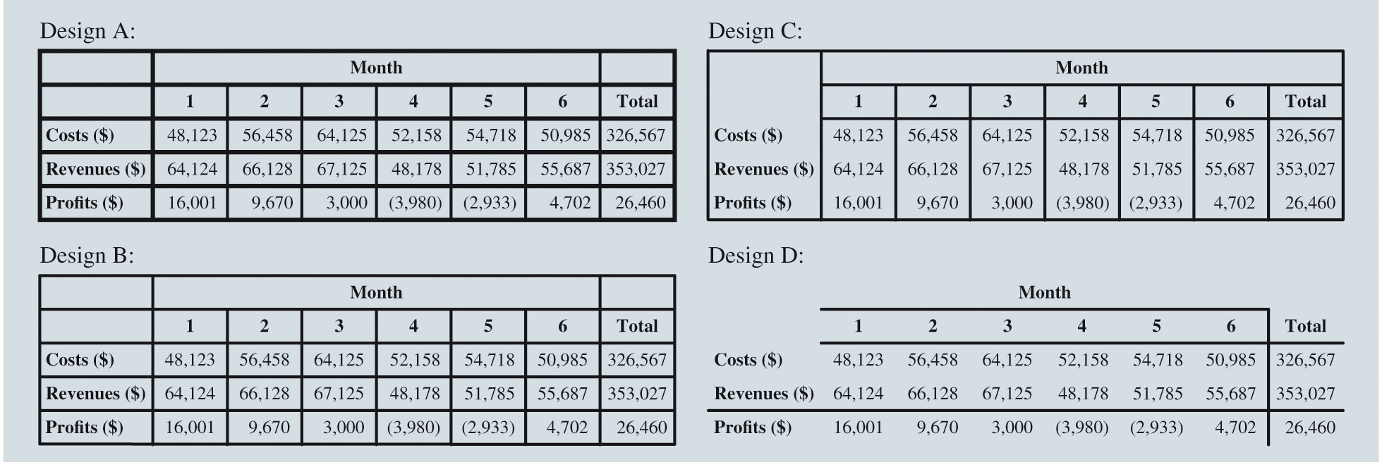
Table design principles
1. Avoid using vertical lines unless necessary.

Slide 9
Table design principles
2. Use shade or vertical lines for large tables to differentiate columns and rows.
Revenues by Location ($) | Month 1 | Month 2 | Month 3 | Month 4 | Month 5 | Month 6
Temple | 8,987 | 8,595 | 8,958 | 6,718 | 8,066 | 8,574
Killeen | 8,212 | 9,143 | 8,714 | 6,869 | 8,150 | 8,891
Waco | 11,603 | 12,063 | 11,173 | 9,622 | 8,912 | 9,553
Belton | 7,671 | 7,617 | 7,896 | 6,899 | 7,877 | 6,621
Granger | 7,642 | 7,744 | 7,836 | 5,833 | 6,002 | 6,728
Harker Heights | 5,257 | 5,326 | 4,998 | 4,304 | 4,106 | 4,980
Gatesville | 5,316 | 5,245 | 5,056 | 3,317 | 3,852 | 4,026
Lampasas | 5,266 | 5,129 | 5,022 | 3,022 | 3,088 | 4,289
Academy | 4,170 | 5,266 | 7,472 | 1,594 | 1,732 | 2,025
Total | 64,124 | 66,128 | 67,125 | 48,178 | 51,785 | 55,687
Costs ($) | 48,123 | 56,458 | 64,125 | 52,158 | 54,718 | 50,985
Right aligned
Same # of digits

Slide 10
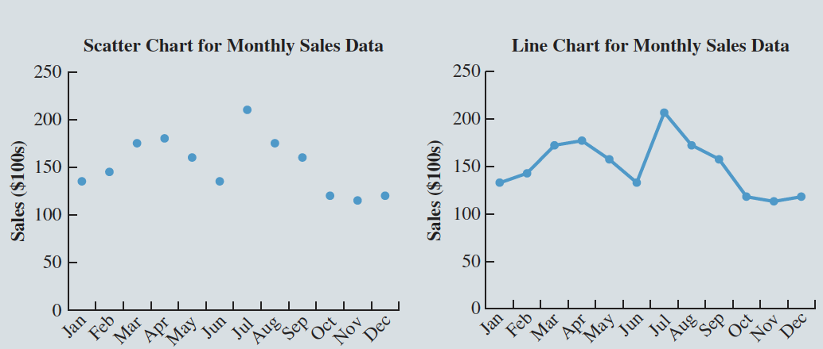
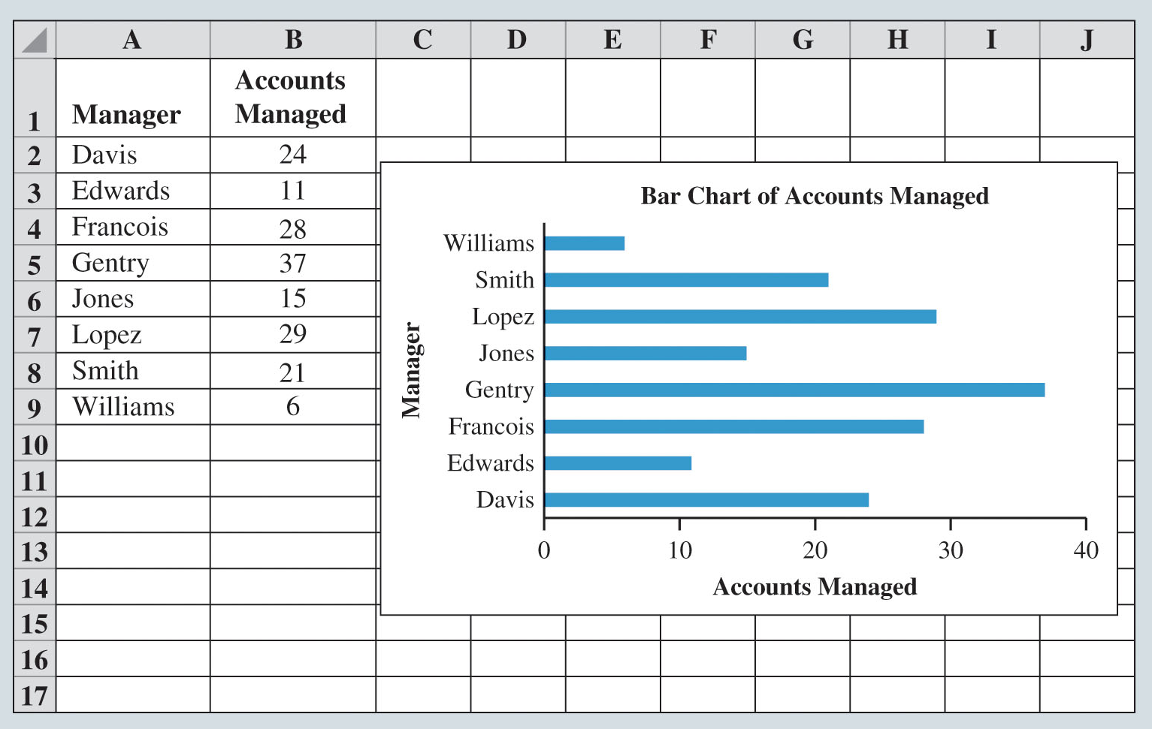
Charts
Scatter chart: Graphical presentation of the relationship between two quantitative variables.
Trend line: A line that provides an approximation of the relationship between the variables.
Line chart: A line connects the points in the chart. Useful for time series data collected over a period of time (minutes, hours, days, years, etc.).
Bar chart: Use horizontal bars to display the magnitude of the quantitative variable.
Column Charts: Use vertical bars to display the magnitude of the quantitative variable.

Slide 11
Charts
Pie chart: Common form of chart used to compare categorical data.
Bubble chart: Graphical means of visualizing three variables in a two-dimensional graph that sometimes is a preferred alternative to a 3-D graph.
Heat map: A two-dimensional graphical representation of data that uses different shades of color to indicate magnitude.

